Slide 1
DENTAL SCAN ANALYZER
BY
KUNGUMA NITHYA.S
B.E CSE
SATHYABAMA INSTITUTE OF SCIENCE AND TECHNOLOGY

Slide 2
ABSTRACT
The Dental Scan Analyzer is an intelligent system designed to enhance the accuracy, efficiency, and automation of dental image analysis. The system utilizes advanced image processing and machine learning techniques to analyze dental scans such as X-rays, CBCT (Cone Beam Computed Tomography), or intraoral images. Its primary goal is to assist dental professionals in diagnosing oral conditions, detecting abnormalities, and planning effective treatments.
The proposed system processes the input dental scan through stages of image enhancement, segmentation, and feature extraction to identify critical regions such as teeth, roots, and surrounding bone structures. By integrating artificial intelligence algorithms, the system can classify dental defects—such as cavities, infections, fractures, and misalignments—with high precision. Additionally, the Dental Scan Analyzer maintains an organized patient database that links diagnostic results with historical records, facilitating better clinical decision-making and treatment tracking.
This project demonstrates the potential of computer-aided diagnosis in modern dentistry, reducing human error and improving diagnostic speed. The integration of data visualization tools also enables dentists to view and interpret scan results intuitively.

Slide 3
EXISTING SYSTEM
In the existing dental diagnostic systems, most dental scan analyses are performed manually by dental professionals using traditional imaging tools and software. Dentists rely on their expertise to interpret X-rays, panoramic images, and CBCT scans to identify dental issues such as cavities, infections, fractures, or bone loss. Although basic image viewing software is available, these tools mainly provide visual representation without any automated analytical capabilities.
Conventional systems lack automation and intelligence, making the diagnostic process time-consuming and prone to human error. Dentists must manually mark regions of interest, measure bone density, and compare multiple scans to detect changes or abnormalities over time. Furthermore, existing systems often do not integrate with patient databases, making it difficult to maintain consistent records and track disease progression effectively.
Variations in experience, lighting conditions, and image quality can lead to inconsistent diagnoses. Traditional systems are designed primarily for visual inspection rather than intelligent analysis, meaning subtle dental problems—such as early-stage caries, micro-fractures, or gum infections—may go undetected in routine examinations.

Slide 4
PROPOSED SYSTEM
The Dental Scan Analyzer aims to overcome the limitations of traditional diagnostic systems by introducing an automated, intelligent, and efficient platform for analyzing dental scans. This proposed system integrates image processing, machine learning, and database management techniques to assist dental professionals in accurately identifying and diagnosing oral conditions from X-ray or CBCT images.
The system processes the input dental scan through several key stages: image preprocessing, segmentation, feature extraction, and classification. In the preprocessing stage, noise is removed, and image contrast is enhanced to improve visual clarity. The segmentation module then isolates important structures such as teeth, roots, and bone regions. Feature extraction identifies patterns, textures, and anomalies, which are further analyzed using AI algorithms to detect dental issues like cavities, infections, root fractures, and misalignments.
The proposed Dental Scan Analyzer not only enhances accuracy and consistency in dental diagnosis but also significantly reduces analysis time. It supports data-driven decision-making, enabling early detection and preventive care. By combining automation, artificial intelligence, and digital record management, the system promotes a smart, cost-effective, and scalable approach to modern dental healthcare.

Slide 5
ADVANTAGES
High Diagnostic Accuracy: The Dental Scan Analyzer uses advanced image processing and artificial intelligence techniques to provide precise and accurate detection of dental problems such as cavities, fractures, and infections.
Cost-Effective Solution: Compared to expensive commercial diagnostic tools,the dental scan analyzer offer a more affordable and accessible solution for small clinics and research institutions.
Early Detection of Dental Diseases: The system can identify early signs of oral issues that may not be easily visible in routine checkups, allowing for preventive treatment and better patient outcomes.
Reduced Human Error: Automated image interpretation minimizes the chances of diagnostic errors caused by fatigue or human oversight.
Faster Processing: The system quickly analyzes dental scans, providing immediate results and improving clinical workflow efficiency.

Slide 6
DISADVANTAGES
Limited Human Supervision: Excessive reliance on automation may reduce the role of expert judgment, and any system misclassification could go unnoticed without professional verification.
Complex Implementation: Integrating the system with existing hospital or clinic management software may require technical expertise and additional configuration.
Data Privacy and Security Risks: Storing patient dental data and images in digital form poses potential risks if proper cybersecurity measures are not maintained.
Need for Regular Updates: The system must be periodically updated with new datasets and AI model improvements to ensure continued accuracy and reliability.
Limited Generalization: The trained AI models may not perform equally well on all types of dental scans, especially if the dataset used for training is limited or biased.

Slide 7
HARDWARE REQUIREMENTS
The Dental Scan Analyzer requires a reliable hardware setup to ensure smooth operation, accurate image processing, and efficient data management. The system should be equipped with at least an Intel Core i5 (8th Generation) processor or an equivalent AMD processor to handle computation tasks effectively. A minimum of 8 GB RAM is required to support real-time image processing and system performance, although 16 GB or more is recommended for faster operation, especially when dealing with large dental scan images or AI-based computations.
For storage, a 500 GB hard disk or 256 GB SSD is sufficient to store patient records and scan data, but a 1 TB SSD is recommended for high-speed data retrieval and long-term data storage. The system should include a 15.6-inch monitor or larger with Full HD (1920×1080) resolution to provide clear visualization of dental images. For more detailed image analysis and 3D rendering, a 4K monitor can be used. A graphics card, preferably NVIDIA GeForce GTX 1650 or higher, is recommended to support image processing and machine learning tasks efficiently.
The system also requires standard input devices such as a keyboard, mouse, and a high-resolution dental image scanner or digital X-ray device for acquiring scan inputs. Stable network connectivity through Wi-Fi or Ethernet is necessary for data transfer and cloud-based storage.

Slide 8
SOFTWARE REQUIREMENTS
The Dental Scan Analyzer requires efficient and reliable software components to process dental images, perform analysis, and manage patient data effectively. The system can operate on Windows 10 or higher, Linux (64-bit), or macOS, depending on the deployment environment.
To implement the machine learning or deep learning modules that detect dental abnormalities, frameworks like TensorFlow, Keras, or PyTorch are integrated. These frameworks help train models that can classify dental conditions such as cavities, infections, or fractures.
For data storage and retrieval, a MySQL or SQLite database is employed to maintain patient information, dental scan records, and diagnostic reports securely. The system also requires supporting software like Anaconda Navigator or Jupyter Notebook for development and testing purposes.
The software setup provides a powerful, scalable, and user-friendly environment for developing and operating the Dental Scan Analyzer, ensuring high performance in both image analysis and data management.

Slide 9
MODULES
The Dental Scan Analyzer is designed as a modular system that integrates various components to perform image acquisition, processing, and intelligent diagnosis efficiently. Each module performs a specific function and contributes to the overall workflow, ensuring the system operates seamlessly from data input to result generation.
These features help in identifying and classifying various dental conditions. The extracted data is converted into numerical values that are then used by the machine learning model for training and prediction.
The system can automatically detect abnormalities such as cavities, infections, fractures, or misalignments. The output of this module includes diagnostic results with accuracy levels and visual indicators on the image, helping dentists make data-driven decisions.
The reports can be exported in various formats such as PDF or Excel, making them easy to share and store. This module bridges the gap between technical analysis and clinical usability, ensuring that dentists can interpret the results effortlessly.
It uses a database management system (like MySQL or SQLite) to ensure that patient records are securely maintained and easily accessible. The database also supports tracking historical data, enabling comparison between previous and current scans.

Slide 10
MODULES DESCRIPTION
1. Image Acquisition Module
This module is responsible for obtaining dental scan images such as digital X-rays, panoramic images, or CBCT scans from dental imaging equipment. It ensures that the images are captured in the appropriate file format and resolution for analysis.
2. Image Preprocessing Module
The preprocessing module enhances the quality of the input dental image by performing noise reduction, image sharpening, grayscale conversion, and contrast adjustment.
3. Image Segmentation Module
This module divides the preprocessed image into distinct regions to isolate individual teeth and other structures. Techniques such as thresholding, edge detection, contour mapping, or region-based segmentation are applied to identify the boundaries of teeth and detect potential abnormalities.
4. Feature Extraction Module
Once the relevant regions are segmented, this module extracts important features such as shape, texture, intensity, and density from the image. These features help in identifying and classifying various dental conditions.

Slide 11
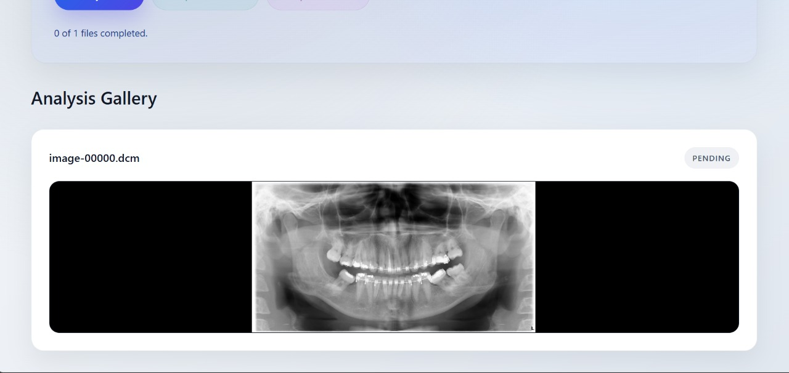
SAMPLE OUTPUTS

Slide 12
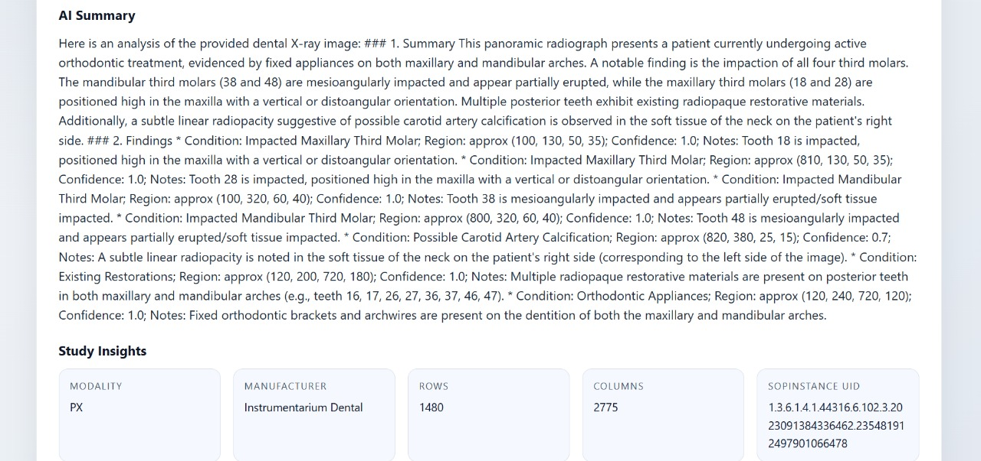
SAMPLE OUTPUTS

Slide 13
CONCLUSION
The Dental Scan Analyzer provides an innovative and intelligent solution to modernize dental diagnosis through automation and artificial intelligence. By integrating advanced image processing and machine learning techniques, the system effectively analyzes dental scans such as X-rays and CBCT images with greater accuracy and efficiency than traditional manual methods. It assists dental professionals in detecting oral issues like cavities, fractures, infections, and bone irregularities at an early stage, leading to better treatment outcomes and preventive care.
This project successfully demonstrates how technology can enhance diagnostic precision while saving time and reducing human error. The inclusion of modules for image preprocessing, segmentation, feature extraction, and classification ensures a structured workflow that delivers consistent and reliable results. Moreover, the patient database and reporting system provide an organized way to manage and review historical data, supporting continuous clinical improvement.

